Slide 1
The Challenges of Managing Inmates with Personality Disorders
name
Name of university

Slide 2
Introduction
The prison environment is one of the most challenging in the world.
Individuals would cause a lot of problems to the people mandated with keeping them in check.
The issue is further complicated by the high prevalence of mental disorders amongst the prison population.
Conducted surveys prove that personality disorder among incarcerated individuals is a critical challenge when it comes to the effective administration of prisons.
Further look at the problems associated with managing inmates with personality disorders.

Slide 3
Challenges
One of the issues associated with prisoners with personality disorders is the cost of their treatment.
Another challenge that prison administrators may face from prisoners with personality disorders is their anti-social behavior.
Drugs and substance abuse
Treating incarcerated individuals with personality disorders as criminals or like mentally challenged persons.
Identification of inmates who suffer from personality disorders.

Slide 4
Cost of their treatment
Facilities operate as businesses aiming to make a profit at the end of the financial period.
It necessary to have an in-house psychiatrist or other mental health professionals.
Inmates for treatment outside their facilities.
Costs of such transfers and the risk of the inmates in question breaking out of jail during the exercise.

Slide 5

Cost of their treatment Con’t
Figure 1: Psychiatric Assessment of an Inmate (Source: https://www.apr.org/post/ohios-top-prison-psychiatrist-testifies-prison-health-trial)

Slide 6
Anti-social behavior
Another challenge that prison administrators may face from prisoners with personality disorders is their anti-social behavior.
Difficult for administrators to achieve this objective with an individual who is reluctant to cooperate.
Constantly harassed making their time within prison walls a living hell.
Administrators are responsible for the inmates’ well-being.
Inmates with borderline personality disorder may also exhibit impulsive behavior.

Slide 7
Anti-social behavior Con’t
Personality disorders also tend to prompt inmates to engage in self-harming behaviors .
Such behavior is bound to cause alarm amongst not only their fellow inmates but also the members of staff.
They may also prompt other inmates to start harming themselves which inconveniences administrators as they run their prisons.

Slide 8
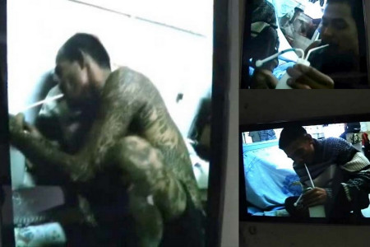
Drugs and Substance Abuse
Drugs and substance abuse .
Figure 2: Drug Use in Prisons (Source: http://www.thaiprisonlife.com/photos/drug-use-in-prison-caught-on-mobile-phones/)

Slide 9
Drugs and Substance Abuse Con’t
Drugs and substance abuse is one of the most prominent factors that land people in jail.
Prove that the prison reform system is failing to carry out its mandate as expected.
drugs interfere with the reasoning capacity of human beings and lead people to do irrational things.
When drug abuse becomes a culture in any prison, it becomes very difficult for wardens and other officers to perform their work effectively.

Slide 10
Treating incarcerated individuals
Treat incarcerated individuals with personality disorders as criminals or like mentally challenged persons.
The law does not provide inmates with personality disorders with the exclusive right to access medical attention like other prisoners with varying health conditions.
There is little screening done to identify individuals with personality disorders, and even after that happens, there is no separate accommodation granted to the said individuals given the level of risk that they pose to their fellow inmates.
There are no special considerations made within the criminal justice system intended at addressing the needs of inmates with personality disorders.

Slide 11
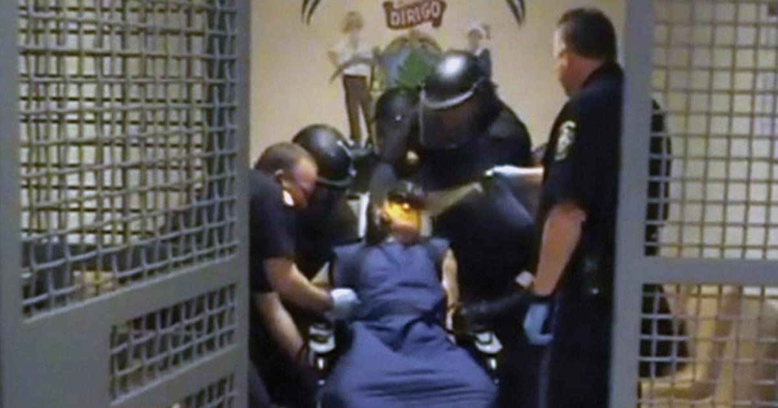
Identification of Inmates
Figure 3: Use of Force on a Mentally Unstable Inmate (Source: https://www.hrw.org/report/2015/05/12/callous-and-cruel/use-force-against-inmates-mental-disabilities-us-jails-and#)

Slide 12
Identification of Inmates Con’t
Individuals with personality disorders tend to act out and engage in various forms of mischief.
Consequently, rather than prescribing psychiatric help for the individual, disciplinary measures, such as solitary confinement, are often taken against the said individuals.
A conflict of interest between the confidentiality of the inmate regarding the data gathered from a psychiatric evaluation and the need for prison officials to assess the said individual’s status arises.
The official infringes on the confidentiality of the inmate, which gives rise to violent situations.

Slide 13
Conclusion
Personality disorders are prevalent in prison systems.
Bring along numerous challenges to administrators.
The costs associated with treatment are usually prohibitive.
Such inmates also exhibit anti-social behavior which negatively impacts their well-being and that of their peers.
They act impulsively making it hard to predict their next course of action, and they also have a tendency to abuse drugs, which can explode into an epidemic.
The inmates can also be deceitful and apply malingering techniques which can prove hard to identify.

Slide 14
References
Conn, C., Warden, R., Stuewig, J., Kim, E. H., Harty, L., Hastings, M., & Tangney, J. P. (2016). Borderline personality disorder among jail inmates: How common and how distinct?. Corrections Compendium, 35(4), 6-13.
Daniel, A. E. (2007). Care of the mentally ill in prisons: Challenges and solutions. The Journal of the American Academy of Psychiatry and the Law, 35(4), 406-410.
Konrad, N., & Opitz-Welke, A. (2014). The challenges of treating the mentally ill in a prison setting: the European perspective. Clinical Practice, 11(5), 517-523.
Pittaro, M. (2015, September 22). The challenges of incarcerating mentally ill inmates. Retrieved from https://inpublicsafety.com/2015/12/the-challenges-of-incarcerating-mentally-ill-inmates/

